Slide 1
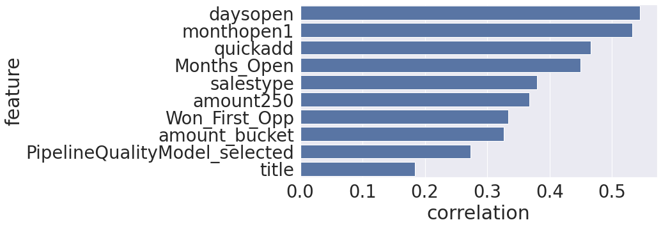
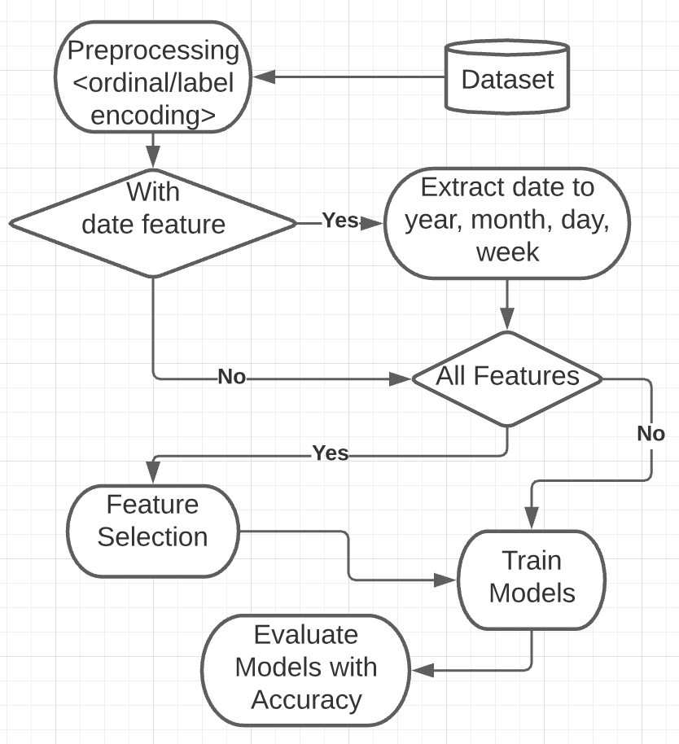
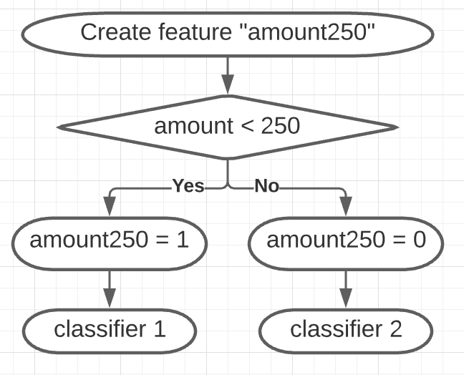
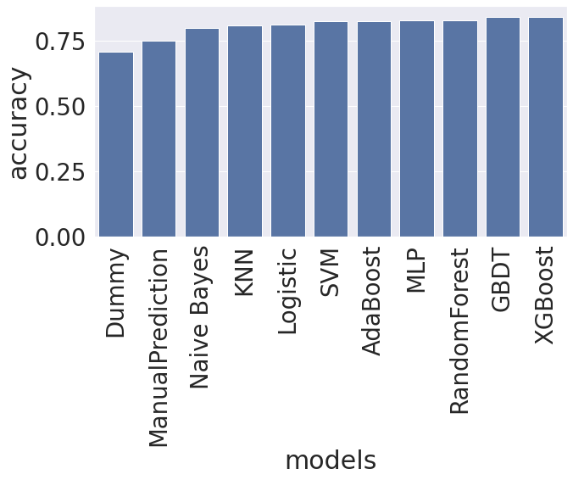
Service Express Sales Outcome Prediction
Wang, Peiyan
peiyanw@umich.edu
School of Information
Team - W.Z.
SI 670 - Applied Machine Learning
School of Information, University of Michigan
Zhao, Zhengyang
zzyang@umich.edu
School of Information
Introduction
The purpose of the project is to predict whether the company can win an opportunity from its potential customers and generate a model with 85%-90% accuracy. We applied data manipulation and feature selections and tried multiple prediction models to find out the best model.
Results
Amount and open duration are important indicators for outcome prediction
Training two models on the splitted dataset has a much better accuracy
Conclusions
Amount and open duration are important features for prediction.
Most successful sales have amount less than $250 and open duration less than 30 days.
Training two classifiers on two subgroups has accuracy as best as 0.85.
Figure 1. The top10 important features for sales outcome prediction. Amount (amount250, amount_bucket) and open time (daysopen, monthopen1, Month_open) are strong indicators for the outcome prediction.
Materials and methods
Discussion
Accuracy can reach as high as 0.85 with feature whether amount over $250. But the project has limitations. 1) Excluded data with amount over $2,000 while training model that likely cause high bias when predicting opportunities with amount over $2,000. 2) Trained model on data with closed opportunities so that open duration is not available, which violates actual situation.
Figure 2. The accuracy of different models training on the splitted dataset. XGBoost and GBDT classifiers perform best. The accuracy score can be as high as 0.85 after tuning parameters.
Notes:
‹#›

